Slide 1

A Brief Overview of the UNIX Command Line
AAFC Bioinformatics Conference and Workshop
September 19-20, 2019, Lethbridge, Alberta
Miles Buchwaldt
Biology Study Leader – Bioinformatics, Saskatoon RDC
19 Sept. 2019

Slide 2
Table of Contents
1. Basic Commands
2. Input & Output
3. The Environment
4. Non-standard Software
5. Regular Expressions
6. Scripting

Slide 3
Initial Setup
Create a secure shell on the remote server:
$ ssh <username>@<address>
Run a script to setup the workshop environment:
$ ./workshop_setup.sh

Slide 5
What is the command line?
User interface, where a user can issues “commands” to the computer carry out various tasks.
Commands follow a strict format:
$ <command> <options> <arguments>
<command>: an executable file on the system
<options>: flags that change the default behavior of the program
<arguments>: information the program requires to carry out it’s task

Slide 6
Locating Files and Directories
Where am I?
$ pwd
What is around me?
$ ls
How do I leave this place?
$ cd

Slide 7
Create, Move, Delete Files
Creating files:
$ touch
Copying/Moving files:
$ cp
$ mv
Deleting files:
$ rm

Slide 8
Reading File Contents
Print a file:
$ cat
Print the top/bottom of a file:
$ head
$ tail
View paginated version:
$ less

Slide 9

Input and Output
Text Streams
Redirection
Pipes

Slide 10
Text Streams
Text streams are blocks of characters, usually separated by newlines.
They are NOT the same thing as text files
Examples: STDIN, STDOUT, STDERR
Most commands take input from STDERR, output to STDOUT and if there are errors, send error information to STDERR

Slide 11
Redirection
These three text streams can be redirected (most often using files)
Redirect STDIN (read from file)
$ cat < text.txt
Redirect STDOUT
$ cat text.txt > another_text.txt
Redirect STDERR (and append
$ cat text.txt 2>> errors_text.txt

Slide 12

The Environment
Variables
Permissions
Important Directories

Slide 13
Where do commands go?
The “interpreter”, sh, bash, perl, python
Variables:
$PATH, $HOME, $USER
Print a variable’s contents with:
$ echo <$VARIABLE>
Set a variable with:
$ export VARIABLENAME=”New value”
*$ export PATH=$PATH:/path/to/new/software*

Slide 14
Environment Setup
~/.bashrc, ~/.bash_profile
Edit these files with a text editor
Must restart shell session, or source the files before changes come into effect:
$ source ~/.bash_profile

Slide 15

Software
READ THE DOCUMENTATION! You can usually find it in INSTALL.txt, README.*, the GitHub page, the wiki, or with a google search.
Installation
Execution
Troubleshooting

Slide 16
Installing New Programs (via git)
Download a git repository
$ git clone https://github.com/lh3/bwa.git
Look out for special instructions that pertain to you
Likely a local installation!
./configure --prefix=~/bin

Slide 17
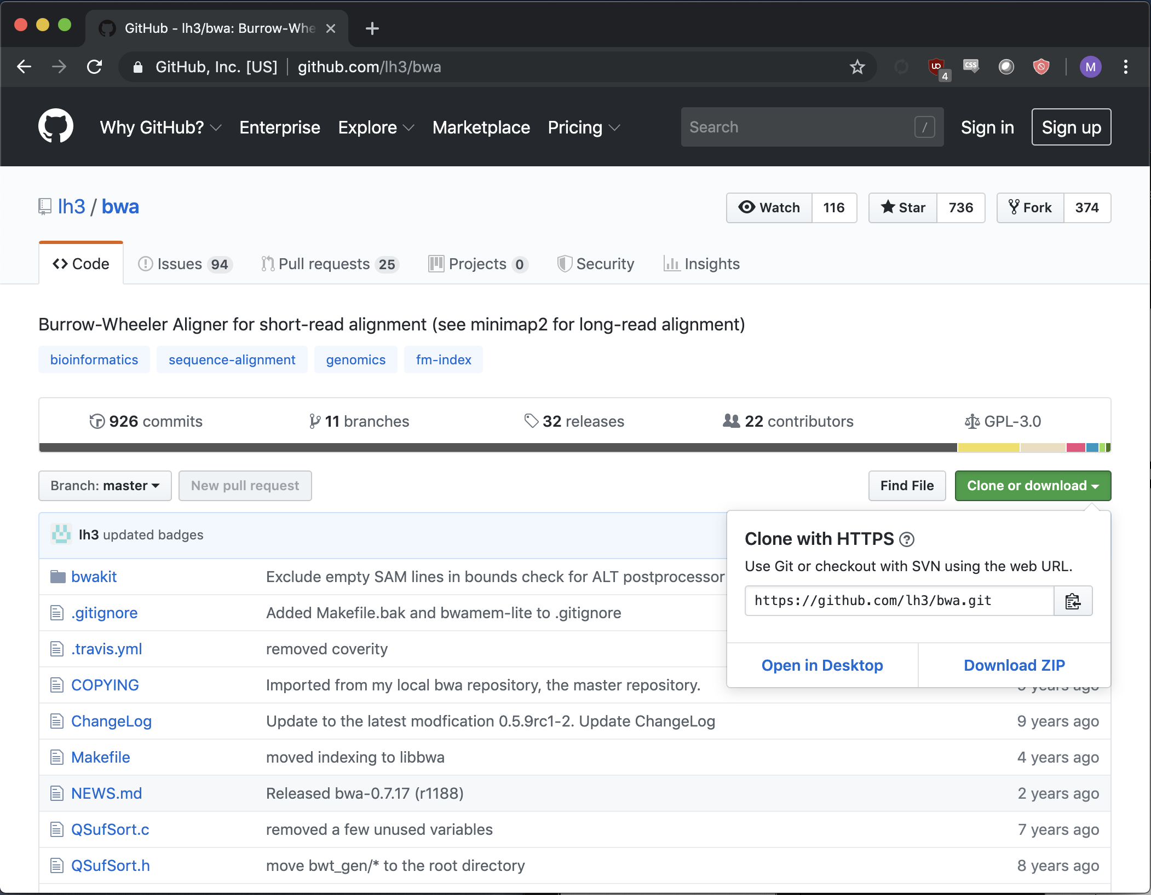
To get github link:
CLICK THIS

Slide 18
Make and Makefiles
./configure [--prefix=~/bin]
make
make install
Look out for errors in the above and Read Them
Most likely causes for compilation errors are missing or incorrect version of dependencies.

Slide 19

Dependencies
Instructions for software requirements usually come before installation instructions.
Make sure this software is installed
Some dependencies will require administrative priviledges (superuser)
Libraries, compiler versions,
Some dependencies can be installed by the user as long as the required version is specified in environment variables.

Slide 20
Running Software
Read Documentation: README.txt, README.md, etc.
$ <command> <options> <arguments>
$ java -jar /path/to/software.jar <options> <arguments>
$ perl script.pl <options> <arguments>
$
Make sure you understand what the command will do before you press enter!

Slide 21
Monitoring Jobs
top, PID, ps, kill,

Slide 22
Regular Expressions (shell)
Wildcards
Loops

Slide 23
Wildcards
Wildcards are special characters that have special meaning to the interpreter

Slide 25
Shell Scripts
Variables
Conditionals
Loops

Slide 26
Variables
Store data

Slide 27
Conditionals
Run a code segment only if a condition is satisfied
Useful for specific tasks, and also to avoid error states

Slide 28
Loops
Run a code segment multiple times
Common pitfalls:
Infinite loops
Off-by-one errors
Different types:
For loops
While loops
Recursion (too complicated for this workshop and rarely required)

